Slide 1
Bandwidth-efficient Live Video Analytics for Drones via Edge Computing
Junjue Wang, Ziqiang Feng, Zhuo Chen, Shilpa George (CMU), Mihir Bala (U Michigan), Padmanabhan Pillai, Shao-Wen Yang (Intel Labs), and Mahadev Satyanarayanan (CMU)

Slide 2
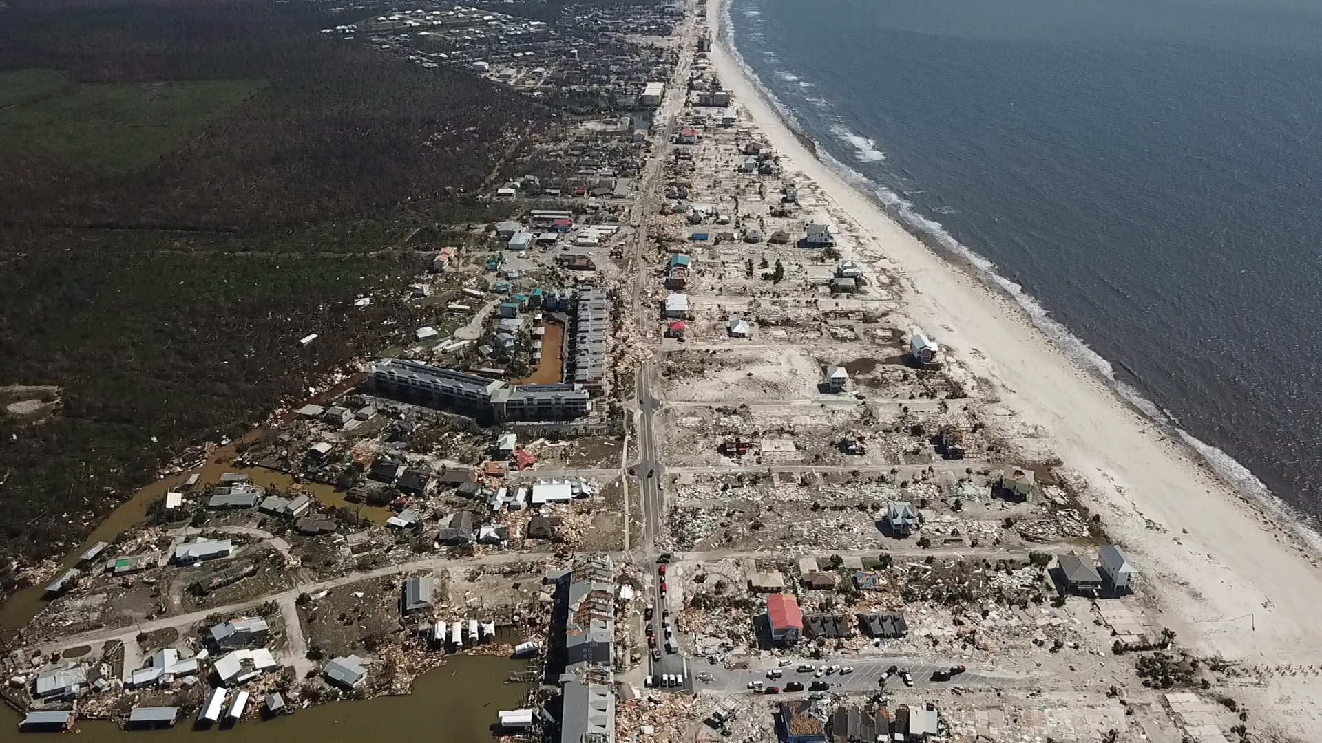
Notes:
From Washington Post. Hurricane Michael. Oct 10. Location is Mexico Beach Florida.
https://www.youtube.com/watch?v=CxDAMUY1LQk

Slide 3
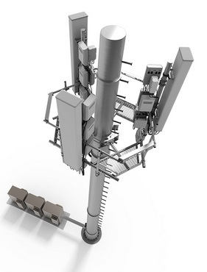
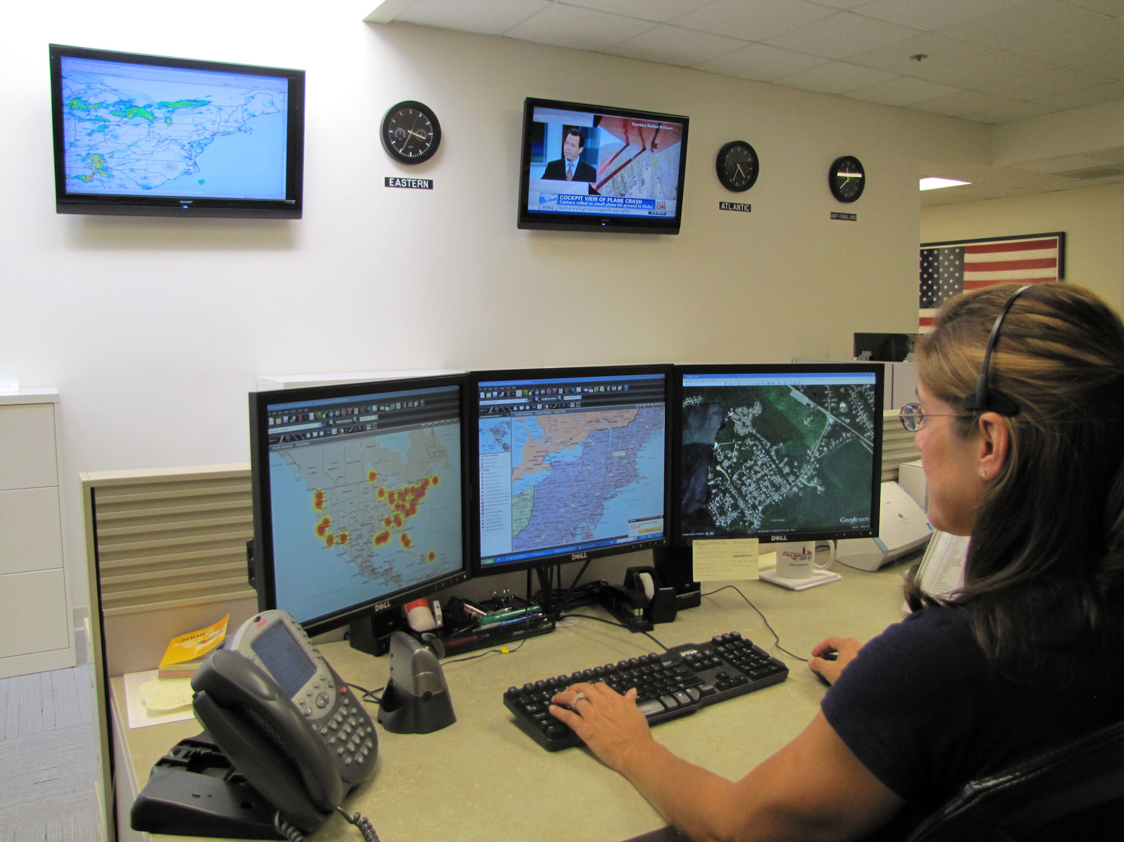
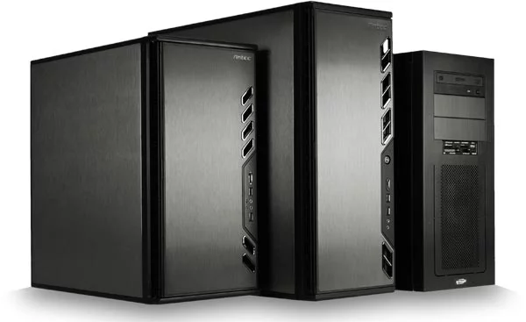


Slide 4
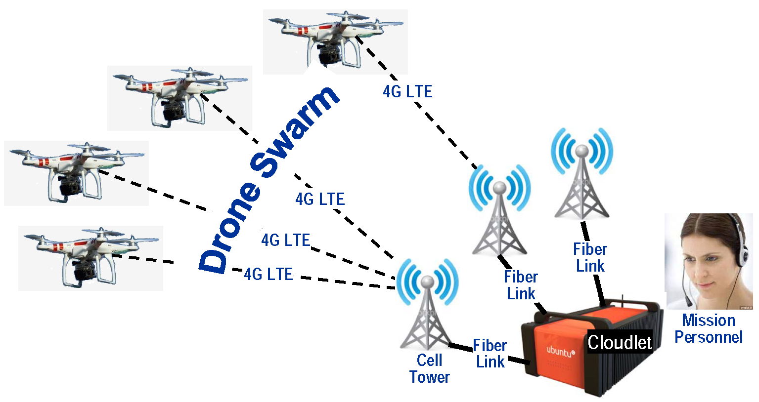
Key technical challenge is how to enable efficient live video analytics for drones.
Notes:
Real-time:
Search and rescue + military. Timing is the key. Racing against the clock
Open the possibility to change the flight path based on analytical results.
Efficient:
Attention of operators is limited: autonomous drones + analytics
Efficient use of system resources: wireless bandwidth, and processing power
Transition:
Focus on object detection (DNN has made progress)
==========================================================
For example
In a search-and-rescue mission after a natural disaster, rapid discovery of survivors is the dominant concern even if it involves considerable use of wireless bandwidth.
In contrast, stealth may be a crucial requirement of a military mission. This requires wireless transmissions from the drone to be kept to the lowest level that is consistent with the maximum tolerable delay in threat reporting.
Flash storage to preserve captured video at full fidelity can also fit easily into such a drone. For example, a 16 GB flash chip can store over five hours of HD video, using Netflix’s estimate of 3 GB per hour [24]. Finally, as GPS navigation apps on modern smartphones suggest, the sensing and processing capability of even a low-end smartphone today is adequate for basic GPS-based autonomous navigation and flight control
Small Drones: just powerful enough to carry a smartphone as payload
Cheap and easy to purchase, operate and maintain
More maneuverable + less prone to interfere with other drone traffic
Likely to receive favorable consideration in flight regulation
Real-Time Video Analytics
Disconnected flight delays the discovery and use of knowledge in the captured data by a substantial amount

Slide 5
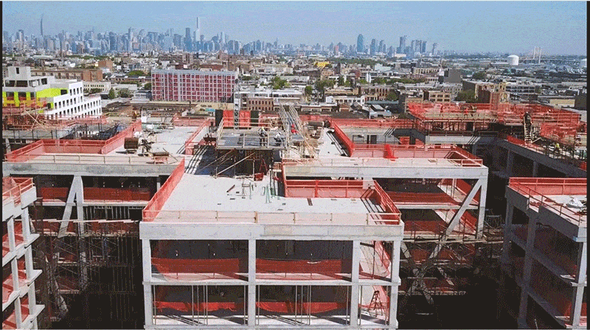
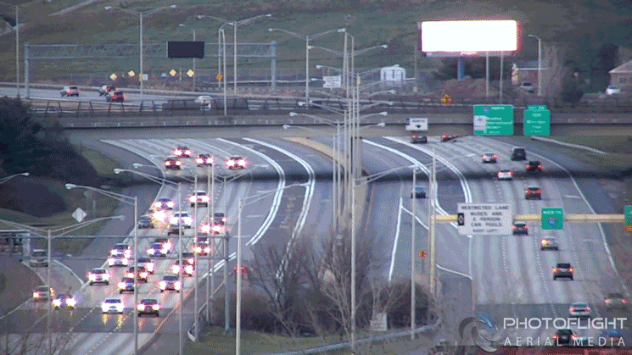
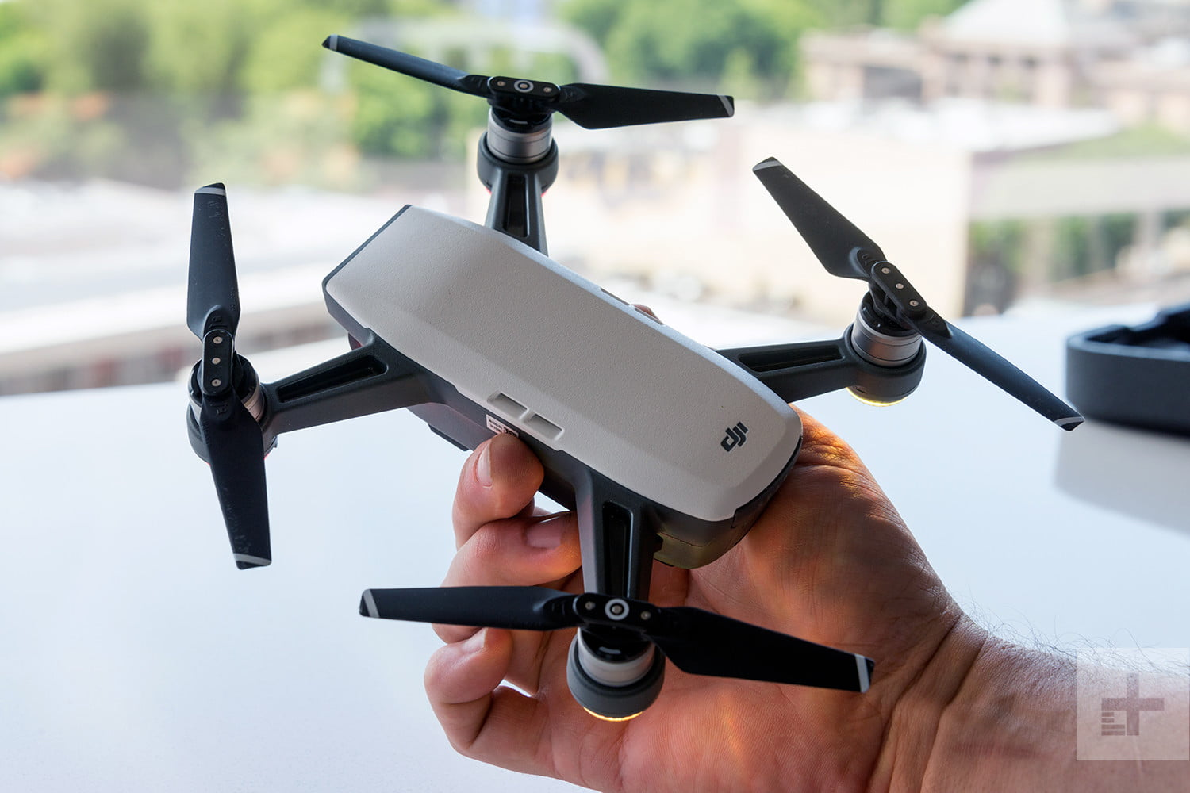
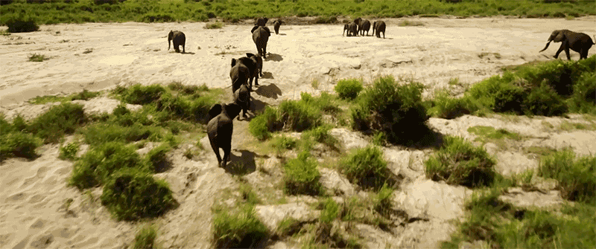
Motivation
$499
300g
31 mph
Simple CV
Autonomous (By hacking)
Notes:
Autonomous
Simple CV: object tracking, hand detection

Slide 6
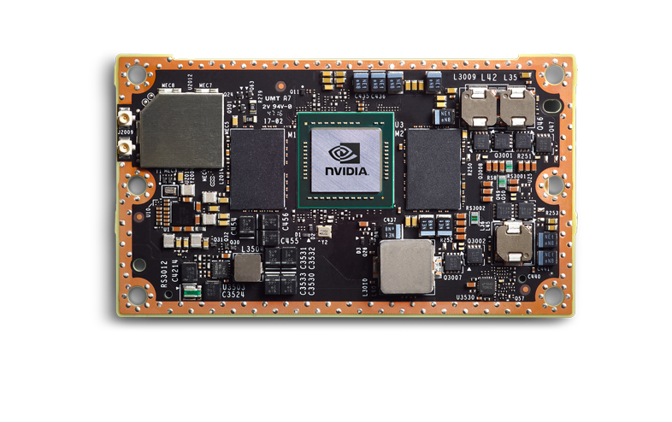
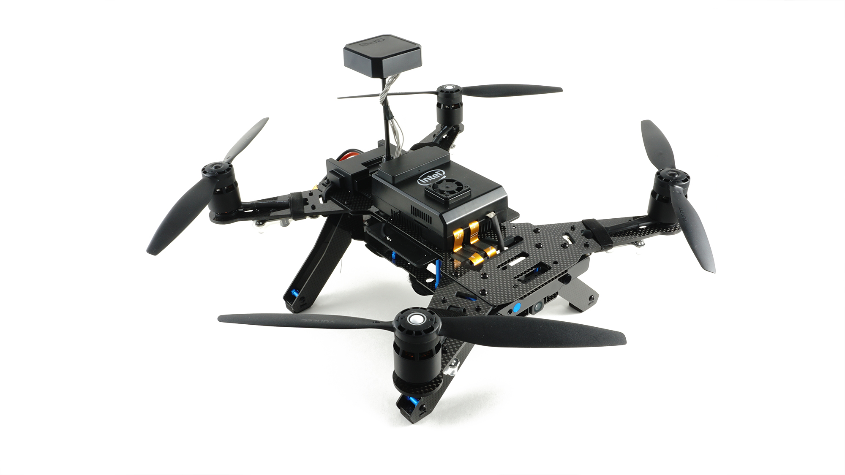
Constraints
 | Intel Aero Drone | Nvidia Jetson TX2
Rack Server (ms)
2x 36-core 2.3 GHz Xeon Processors, 128GB Mem, NVIDIA Tesla K40 (2880 CUDA cores)
4 ±0 ms
438 ±5 ms
Specs | 4-core 1.7 GHz Intel Atom, 4GB RAM, Gen 9 Graphics | 6-core 2.0 GHz ARM Cores, 8GB Mem, NVIDIA Pascal 256 CUDA cores
Processing capability
Object Detection (SSD-InceptionV2) | 860 ±27 | 285 ±7
Image Classification (MobileNet) | 42 ±1 ms | 13 ±0 ms
Object Detection (FasterRCNN-ResNet) | 13340 ±59 ms | Out of Memory
Notes:
(No need to explain everything, simple verbal explanations)
One way to enable such a system is to process everything locally
What is a good estimate of the computation platforms that would be available on drones?
Here are some drone models or chip we found: Intel Aero, and Nvidia Jetson TX2
They have serious compute power onboard. Much more than an Arduino or a rasberry pi. Tradeoff of cooling
To put into perspetive on how much of these h/w can run on vision analysis, in particular DNN-based vision, here are some number:
We are able to run some simple/shadow DNNs at full frame rate while the most accurate models are too slow or require too much memory
On the other hand, the most recent servers can run these model much faster
NVIDIA jetson TX2 are running on GPU
Intel numbers are running on CPU. MobileNet numbers uses Intel CV-SDK
We can run sophsiscated DNN processing on the drone, but not the state-of-art models. Need an offloading approach.

Slide 7
Constraints
10 Mbps needed for drone-encoded HD video at 25 FPS
Processing capability
Wireless bandwidth
LTE Advance Peak Uplink b/w 500 Mbps per cell
Balloon-provided LTE 10Mbps
Notes:
Another way to realize such a system is to stream all the video to the backend for analysis.
However, mobile network, especially cellular network is highly variable in performance and reliability. Just 10-20 drones each can saturate the uplink capacity.
We may need to rely on emergency network (balloon-provided LTE)
================================================================================
Mobile connectivity is highly variable in performance and reliability
stated uplink capacity of a cell in 4G LTE Advanced technology is only 500 Mbps
Just a few swarms of 10-20 drones each can saturate the uplink capacity of a macrocell whose coverage area may be larger than 100 square kilometers in rural areas.

Slide 8
System Design Goals
adaptive computer vision pipeline for small drones that leverages edge computing and enables dynamic, mission-specific optimizations
Proposed and evaluated 4 techniques for such a pipeline
Notes:
delay between first capture of a video frame in which a particular result (e.g., image of a survivor) is present, and report of its discovery to mission personnel after
video processing.
Filterfoward: scaling out # of detection tasks
occasional human attention
output of each video processing pipeline should only demand occasional human attention
Scalability, in terms of maximum number of concurrently operating drones within a 4G LTE cell becomes an important metric.
uplink capactiy of a macrocell whose coverage area may be larger than 100 square kilometers in rural areas.

Slide 9

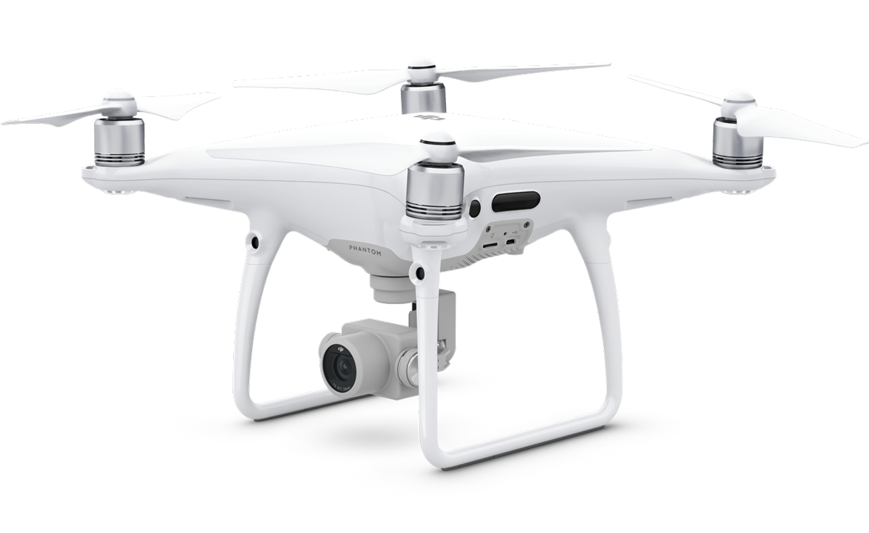
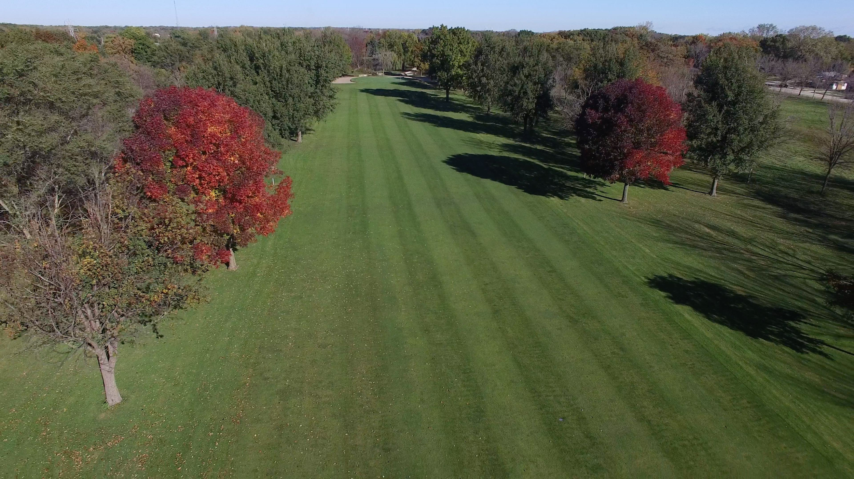
Techniques
Interesting!
Has a Car!
Has a Car!
EarlyDiscard
Just-In-Time-Learning (JITL)
Context-Awareness
ReachBack
Boring
To Cloudlet
Has a Car!
Store Locally Only
Boring
Notes:
Add some explanations of reachback and context-awareness?
Explain each of them briefly with a few sentences
How these four techniques interplay with each other? -> maybe a backup slide
Very short descriptions of each technique (intuitive explanations)
Context-awareness: exploit low-hanging fruit

Slide 10
Technique 1 - Early Discard
Decode
Encode
Example Early Discard Filters
Pre-processing
MobileNet DNN
State-of-Art DNNs
Camera
AlexNet DNN
...
Drone Storage
Notes:
Weak classifiers including some inexpensive DNNs (on the drone)
Some image-based examples of the early discard filters
High-level explanation of this slide (animation, drop at drone)
Make the point of everything is stored with drone storage (Reachback)
Add Back-up slides to answer the question of pixel-level preprocesssing
Question: swarm control is not in the scope

Slide 11
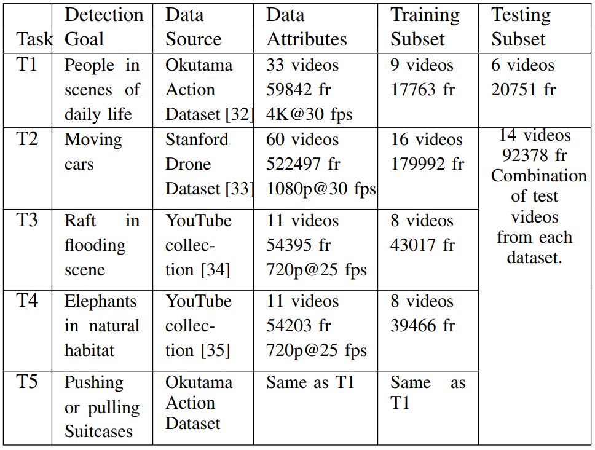
Evaluation
Dataset
Example Videos
T1, T2, T3, T4
Notes:
Color code the different tasks
T1 -T4 object detection
T5 - activity detection

Slide 12
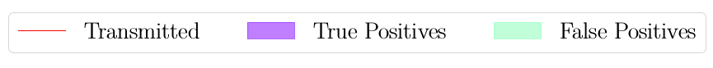
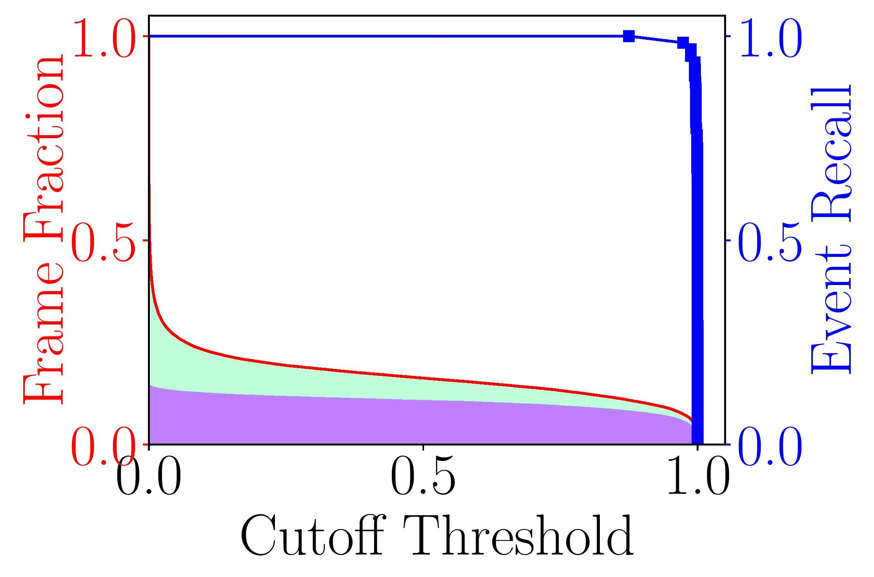
Bandwidth Savings
with Early Discard (T1)
Notes:
Could spent more time explaining these graphs.
Cutoff threshold intuition to frame fraction, event recall
Show one figure

Slide 13
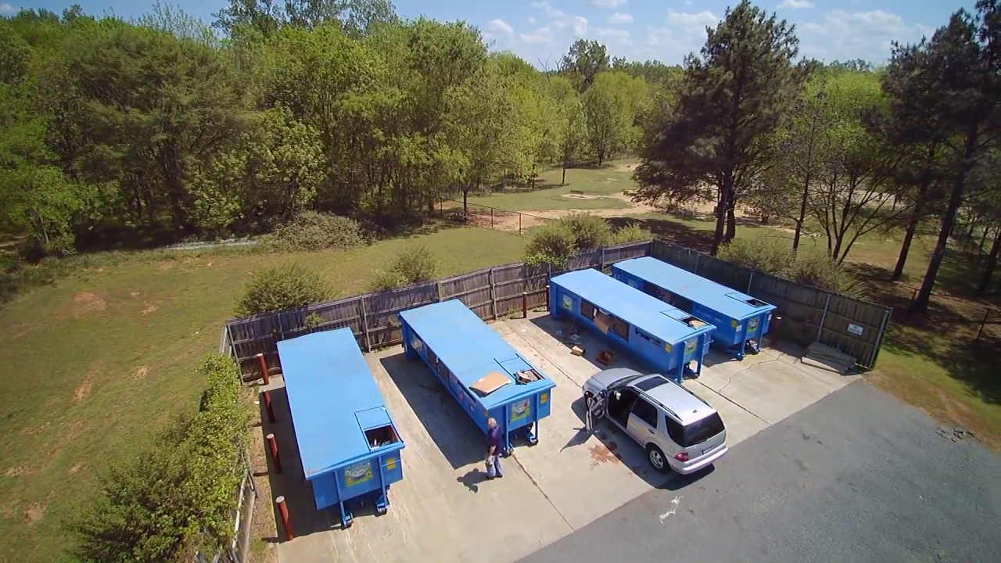
Techniques
Not a Car!
False Positive!
Has a Car!
Interesting!Has a Car!
EarlyDiscard
Just-In-Time-Learning (JITL)
Context-Awareness
ReachBack
To Cloudlet
To Drone
This is not a car!
Notes:
Add some explanations of reachback and context-awareness?
Explain each of them briefly with a few sentences
How these four techniques interplay with each other? -> maybe a backup slide
Very short descriptions of each technique (intuitive explanations)
Context-awareness: exploit low-hanging fruit

Slide 14
Technique 2 - Just-In-Time Learning (JITL)
Positive
Negative
EarlyDiscard
EarlyDiscard
EarlyDiscard
JITL filter v1
JITL filter v2
Drone
Cloudlet
Update SVM
Update SVM
time
DNN at the Cloudlet
DNN at the Cloudlet
DNN at the Cloudlet
Notes:
Question: how much update overhead?
Reasons for linear SVM

Slide 15

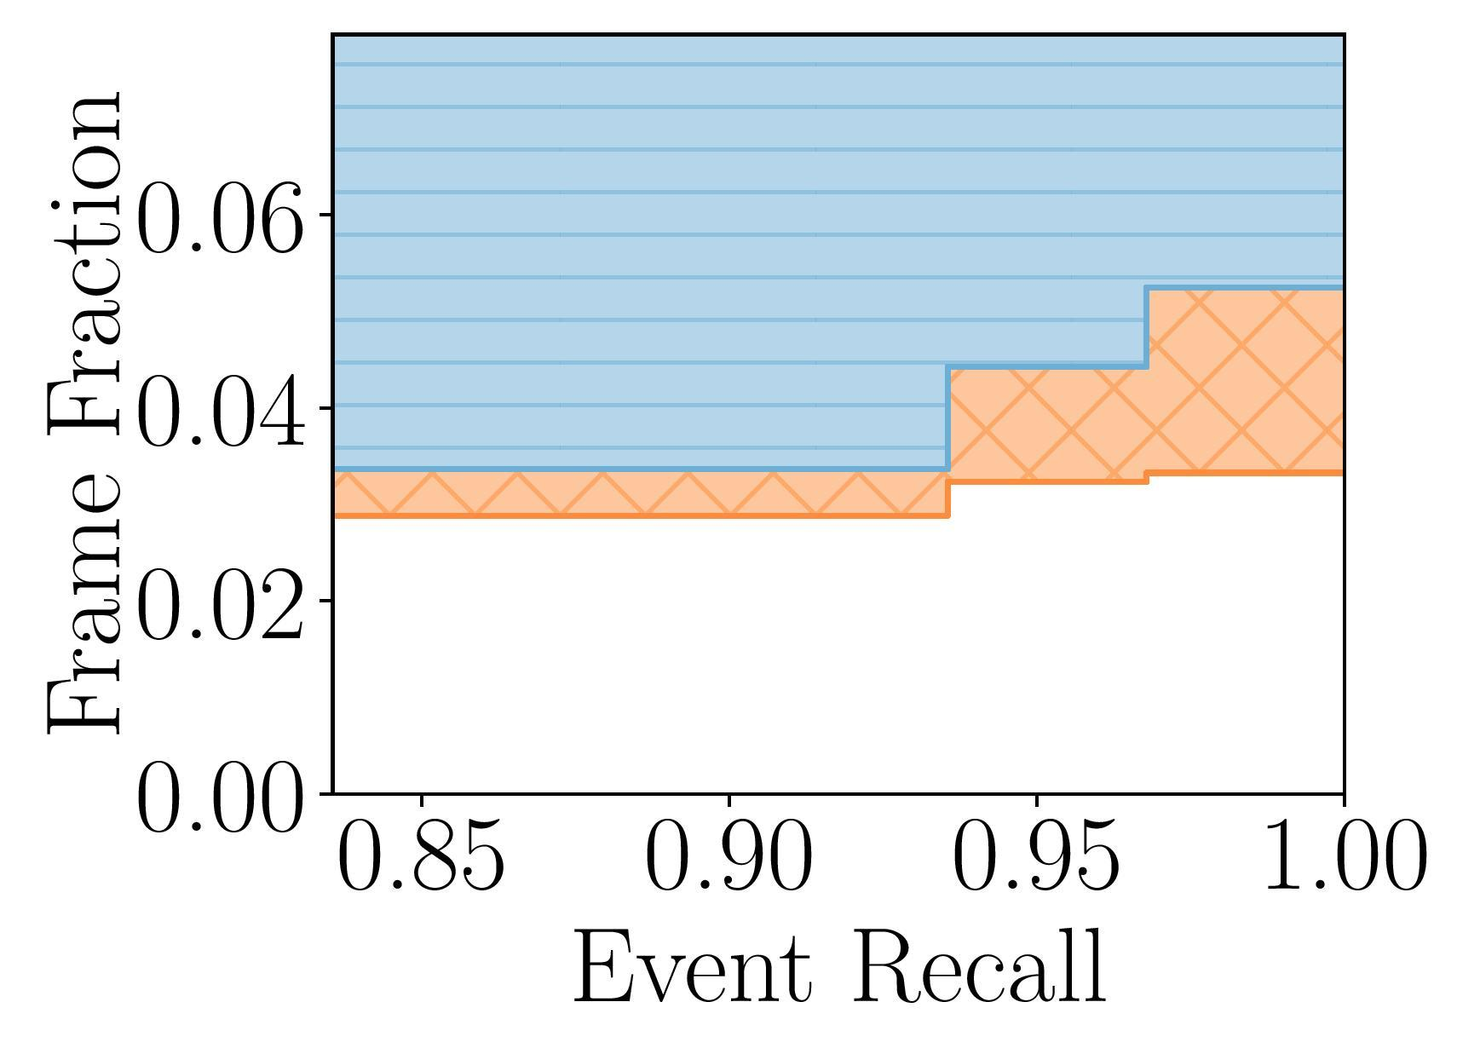
JITL Fraction of Frames under Different Event Recall (T3)
Notes:
Operating regions: move the frontier to lower b/w
Pick a specific event recall
Use a different, easier to understand graph
Just Show one

Slide 16
More in the Paper
DNN-based Vision Processing Time on multiple drone platforms
Four techniques to reduce bandwidth consumption, including Reachback and Context-Awareness
Detailed Evaluation of these techniques
Discussion on how to combine these techniques together to build an adaptive mission-specific computer vision pipeline
Notes:
Their effects on b/w consumption, result latency, and result accuracy
Verbal summaries? Or replicate of the summary

Slide 17
Thank you! Questions?

